Slide 1

Notes:
AI-generated content may be incorrect. ---

Slide 2

Welcome - Team Infinity
Problem Tackled
The team addressed crucial issues in software development and quality assurance defect tracking.
Innovative Solution
A novel solution was created to improve defect tracking and resolution efficiency in software projects.
Approach : Power by AI and usable for layman person .
Hackathons inspire creativity, rapid problem-solving, and teamwork, embraced passionately by Team Infinity.
Notes:
Welcome to the Hackathon Presentation by Team Infinity. We are excited to showcase our innovative approach to defect management, developed during this hackathon event. Our team has worked collaboratively to address a pressing issue in software development and quality assurance. This presentation outlines our journey, the problem we tackled, and the solution we built to improve defect tracking and resolution. Hackathons provide a unique opportunity to foster creativity, teamwork, and rapid problem-solving, and Team Infinity has embraced this challenge with enthusiasm and dedication.

Slide 3

Summary of Problem
Common Defect Management Issues
Duplication of defect reports and lack of prioritization cause inefficiencies in software defect management.
Impact on Software Quality
Inefficient defect management leads to wasted resources, delayed releases, and reduced product quality.
Limitations of Existing Systems
Current systems lack contextual analysis and automated prioritization, causing fragmented workflows.
Notes:
Defect management is a critical aspect of software development, yet many organizations face inefficiencies in this area. Common issues include duplication of defect reports, lack of prioritization, and difficulty identifying which modules are most affected. These challenges lead to wasted resources, delayed releases, and reduced product quality. Our research highlighted that existing systems often fail to integrate contextual analysis and automated prioritization, resulting in fragmented workflows and inconsistent defect resolution. Addressing these problems is essential for improving operational efficiency and delivering high-quality software products.

Slide 4

Solution
Duplication Detection Mechanism
Open AI : Using AI to detect whether the system already contains the defect with the details entered by the user against the existing defect database. The system prevents redundant defect entries using text similarity and metadata comparison techniques.
Context-Based Severity Assignment
Using NLP and vector embedding techniques Severity and priority levels are assigned by analyzing defect contexts to address critical issues promptly. Automated evaluation improves response times, reduces downtime, and aligns defect fixes with business goals.
Train Historical Data
Load the existing Defect data into the database and provide this input to the Model that will train the model to help us perform the defect triaging and refining
*Module Analysis Tool
Identifies high defect density areas, helping teams allocate resources effectively for resolution.
Notes:
Our solution is an automated defect management system designed to streamline the identification, evaluation, and resolution of software defects. It features a duplication detection mechanism that uses text similarity and metadata comparison to prevent redundant entries. The system also incorporates context-based analysis to assign severity and priority levels to defects, ensuring that critical issues are addressed promptly. Additionally, it includes a module analysis tool that identifies areas with high defect density, enabling teams to allocate resources effectively. This comprehensive approach enhances defect tracking, reduces resolution time, and improves overall software quality.

Slide 5
Solution Approach
Solution Workflow
Model Used:
OpenAI GPT-5 is the core AI engine.
Training Approach:
Fine-tuning technique applied on historical defect data.
Vector embeddings created for semantic similarity scoring.
Key Functions:
Duplicate Detection:
Model compares new defect input against embedded historical defects.
Scores similarity and flags potential duplicates.
Compute cosine similarity with the new defects embedding.
when similarity > threshold (e.g., 0.6), alert user (tester).
Severity & Priority Identification:
AI analyzes defect details and predicts severity and priority based on patterns.
Content Refinement:
AI rewrites defect descriptions for clarity and completeness.
User Interaction:
User provides defect details as input.
AI processes input → Generates refined description → Suggests severity & priority → Detects duplicates.
Notes:
Our solution is an automated defect management system designed to streamline the identification, evaluation, and resolution of software defects. It features a duplication detection mechanism that uses text similarity and metadata comparison to prevent redundant entries. The system also incorporates context-based analysis to assign severity and priority levels to defects, ensuring that critical issues are addressed promptly. Additionally, it includes a module analysis tool that identifies areas with high defect density, enabling teams to allocate resources effectively. This comprehensive approach enhances defect tracking, reduces resolution time, and improves overall software quality.

Slide 6
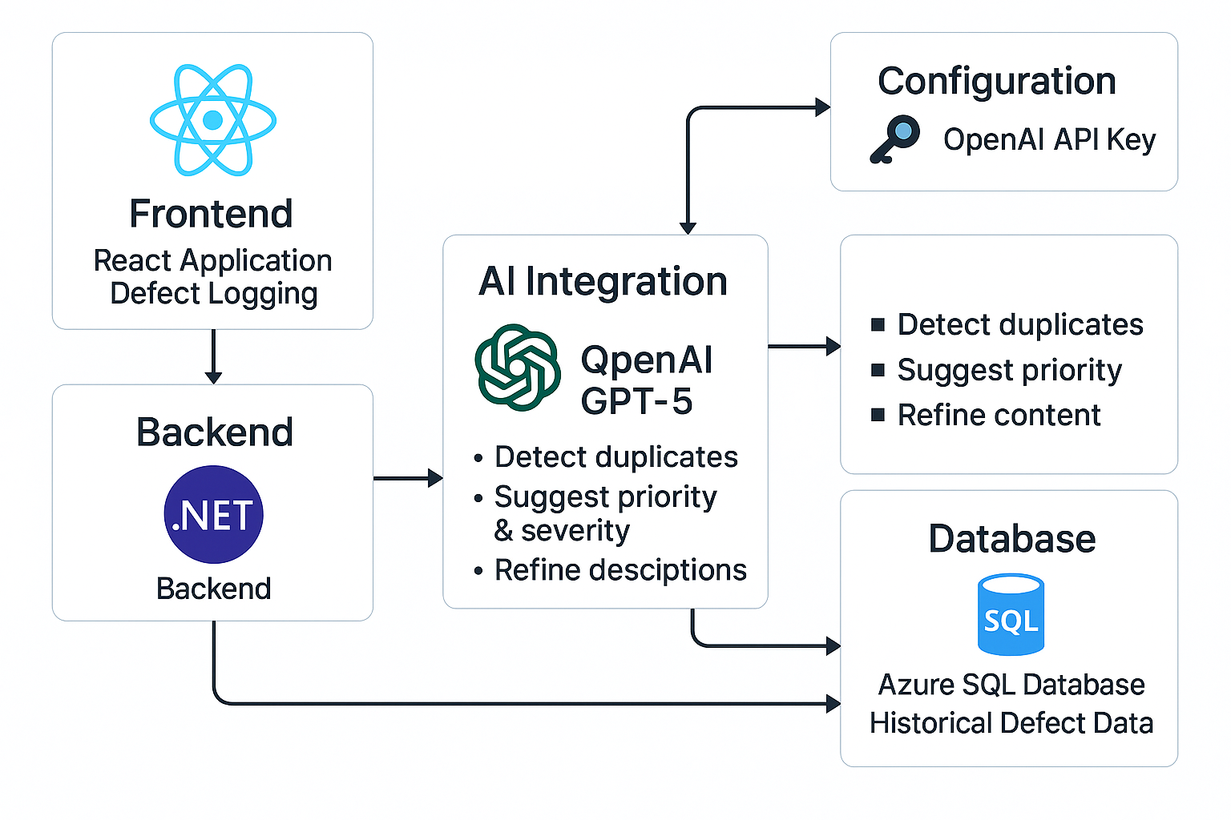
System Diagram

Slide 7

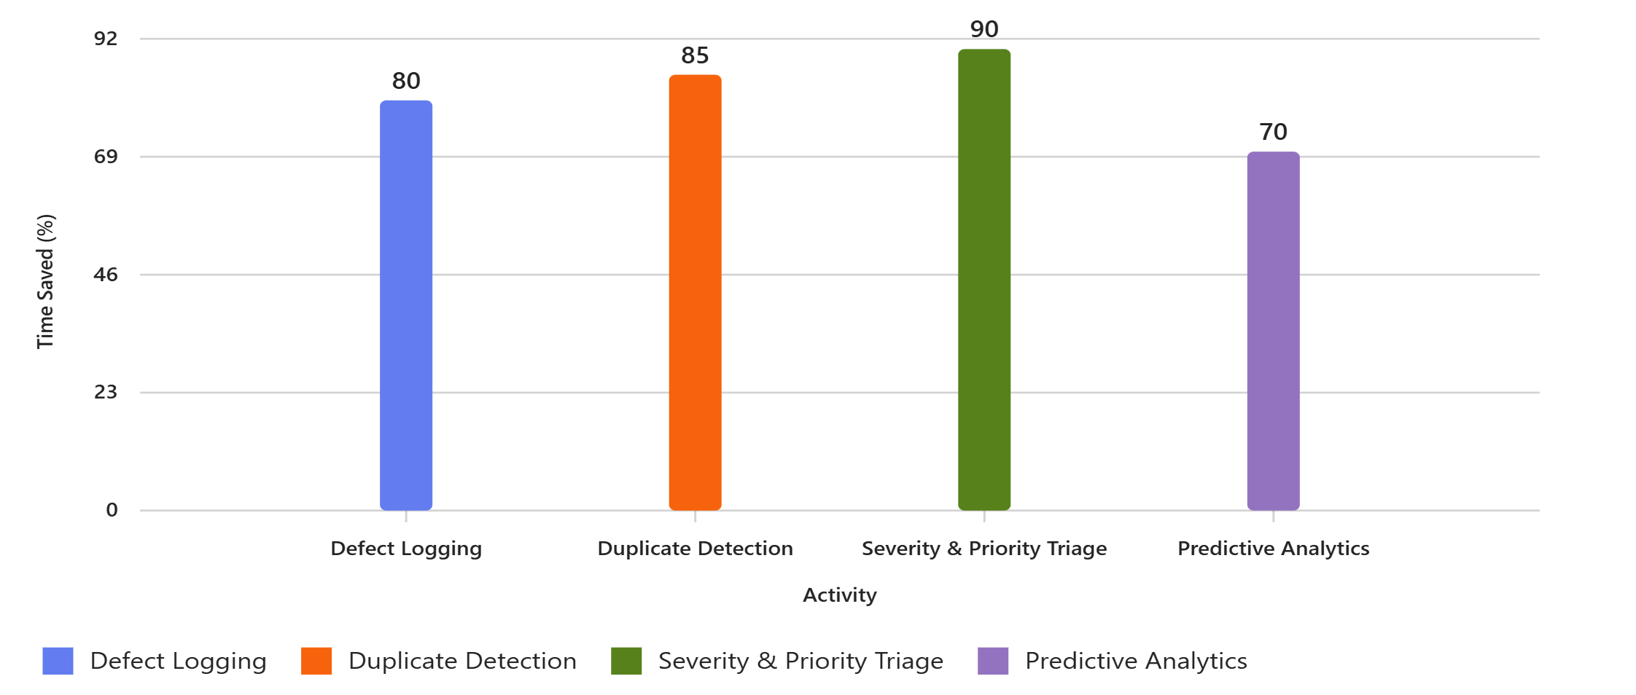
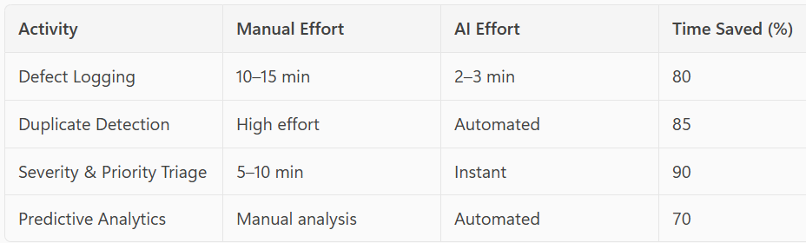
Business Impact
Metric-Driven
Enables data-backed prioritization and continuous improvement, ensuring transparency and accountability.
Cost and Time Reduction
The solution minimizes resolution time and lowers operational costs, boosting overall business performance.
Proactive Quality Assurance – Quality driven
Improves product quality, customer satisfaction, and reduces post-release defects, strengthening brand reputation.
Notes:
Implementing our defect management solution can significantly improve business operations. By reducing duplication and automating prioritization, organizations can streamline their workflows and enhance decision-making. The system minimizes resolution time, lowers operational costs, and boosts customer satisfaction by ensuring timely fixes to critical issues. Furthermore, it enables the identification of high-risk modules, allowing for targeted improvements and proactive quality assurance. These benefits translate into a competitive advantage, better product reliability, and increased trust from users and stakeholders.

Slide 8

Demo

Slide 9
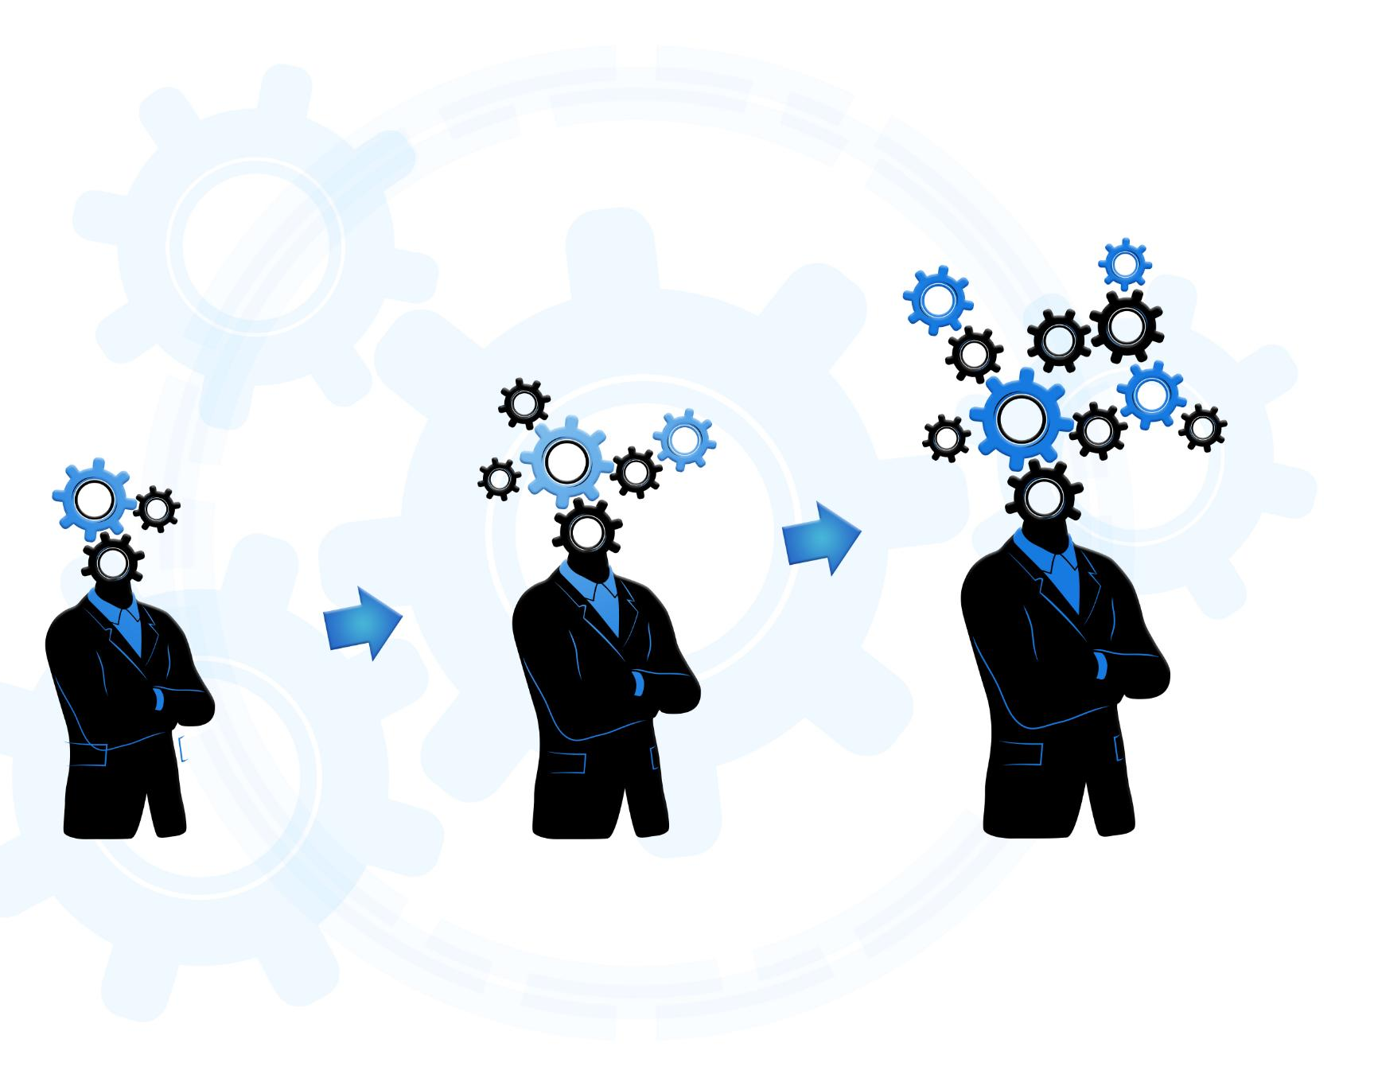
Future
Voice Command Support
Improves accessibility for visually impaired users
Integration with Popular Tools
Seamless integration with platforms like Jira, Azure DevOps, ServiceNow.
Advanced Analytics & Insights
Predict defect trends, root cause analysis, and automated reporting.
Multi-Language Support
Allow defect reporting and AI suggestions in multiple languages
Notes:
In conclusion, Team Infinity has developed a comprehensive defect management solution that addresses key challenges in software quality assurance. Our system prevents duplication, automates severity and priority evaluation, and provides insights into defect distribution across modules. It is scalable, adaptable, and impactful across various industries. The hackathon experience has been a valuable opportunity for learning, collaboration, and innovation. We are proud of our achievements and look forward to further developing and deploying our solution to drive meaningful change in defect management practices.

Slide 10
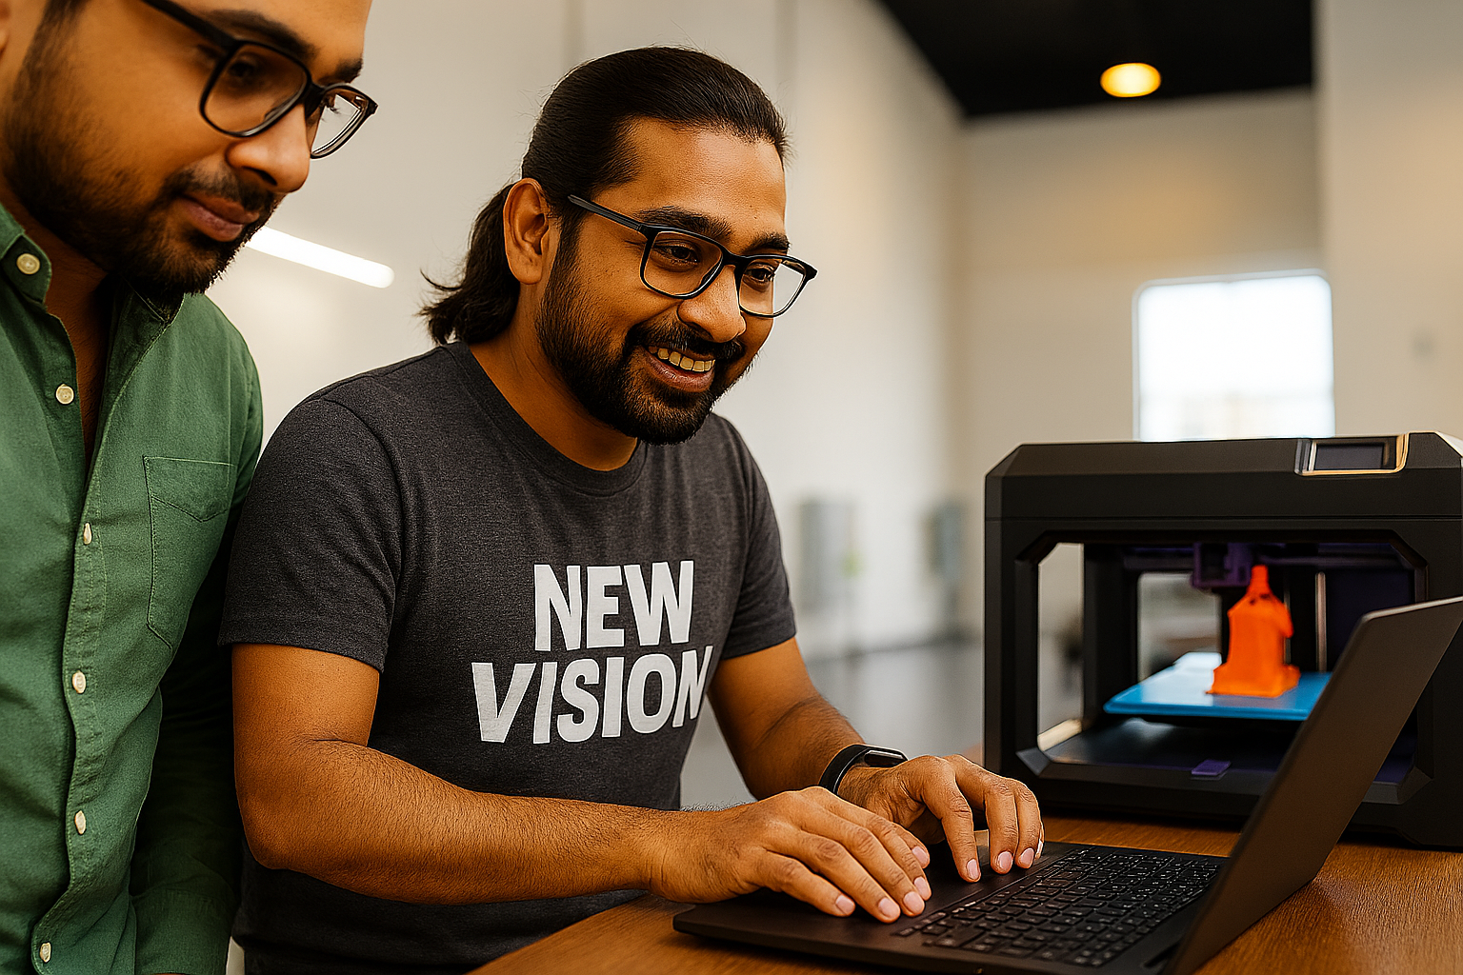
Thank You
Team Infinity
Notes:
Thank you for your time and attention. We appreciate the opportunity to present our project and share our ideas. Team Infinity is committed to continuous learning and innovation, and we welcome feedback and collaboration to enhance our solution further. Your support and engagement are invaluable to us, and we hope to contribute positively to the future of defect management and software development. Let's innovate together and build better systems for tomorrow.

Slide 11

Team Infinity
Kunal Valecha
Yogesh Khurpe
Vikrant Kale
Dipak Bhoi
Sakshi Agrawal
Niraj Khose
Rajesh Kalyankar
Sudarshan Jhawar
Shrikant Thorat
Hatim Johar
Notes:
Team Infinity is composed of four talented individuals who bring diverse expertise to the table. Alice is a skilled developer with a strong background in backend systems and automation. Bob is a data analyst who specializes in pattern recognition and statistical modeling. Charlie is a UX designer focused on creating intuitive and user-friendly interfaces. Dana is a business strategist who ensures our solution aligns with market needs and business goals. Together, we collaborated effectively, leveraging our unique skills to brainstorm, prototype, and refine our defect management solution. Our synergy and communication were key to our success during the hackathon.

